Slide 1
CS 3853 Appendix C (Contd.)
Vijayalakshmi Saravanan

Slide 2
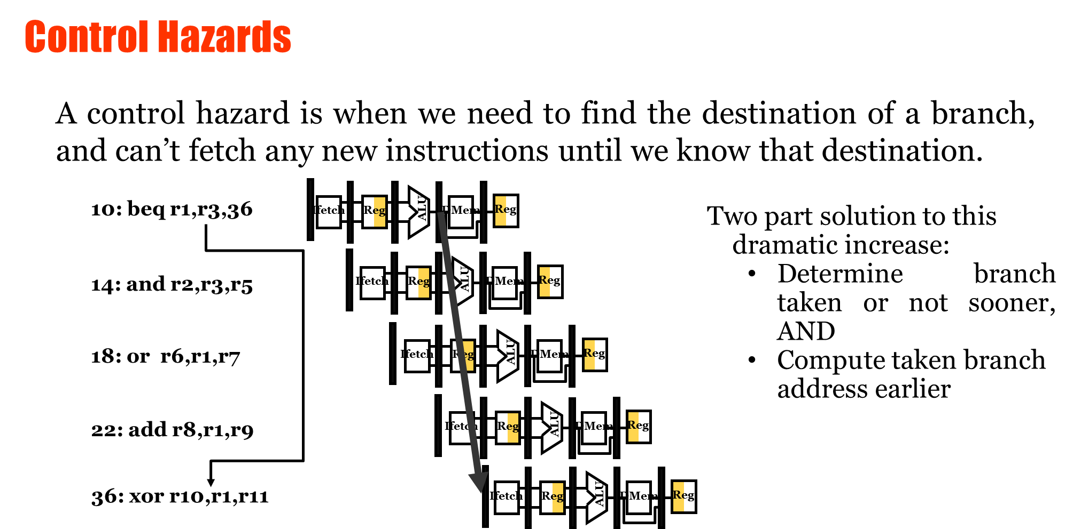

Slide 3
Branch Behavior of pgms.
Conditionals branch dominate
Forward branch dominate
67% of conditional branches are taken!
Usually, backward branches are taken more often than forward ones (loops)

Slide 4
Reducing Branch Penalties (Static Methods)
Static methods : (decision is fixed for entire execution)
Freeze pipeline until branch is resolved => simple
Branch: IF ID Ex Mem WB
Successor: Stall IF ID Ex Mem WB
2. Predict branch not taken :
-> continue as if nothing happens
-> following inst. do not change state (i.e write Reg/mem) until BR is resolved
-> if fail : flush pipeline (i.e. deleting inst. After branch)
3. Predict taken
-> after the decode + target address computed ->
fetch from target ( no advantage in MIPS )

Slide 5
4. Delayed branch
-> the instruction(s) in the branch delay slot(s)
following the branch will be executed no matter what
-> MIPS: 1 delay slot.
-> job of compiler: make sure successor instruction(s) are valid and useful.
branch instruction sequential successor₁ sequential successor₂ ........ sequential successor_{n}
branch target if taken
Branch delay of length n

Slide 6
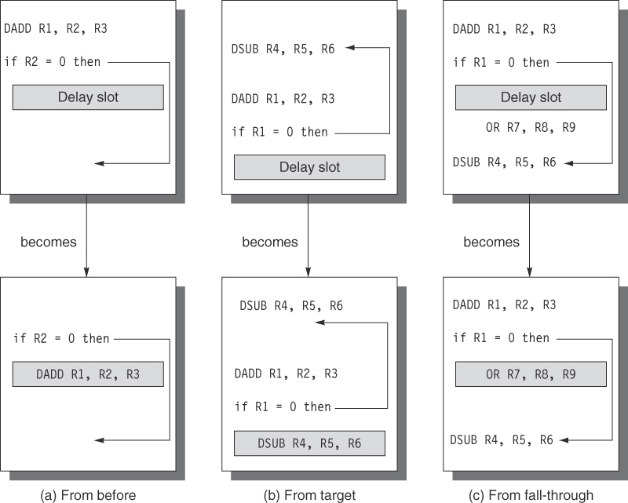

Slide 7
A simplified version of C-25 Example
In MIPS R4000, it takes 3 pipe stages to calculate branch target address and one more stage for condition evaluation. What is the branch penalty for different schemes (flush, pred taken and pred untaken)? [Penalty is defined as expected/average number of stalls]

Slide 8
Handling Multicycle Operations
Floating point operations usually take several EX cycles
There are several floating point functional units
Example : Assume we have 4 separate FU
Integer unit : Ld,St, integer ALU , Br
FL Pt and integer MPY
Fl Pt adder
Fl Pt and integer div

Slide 9
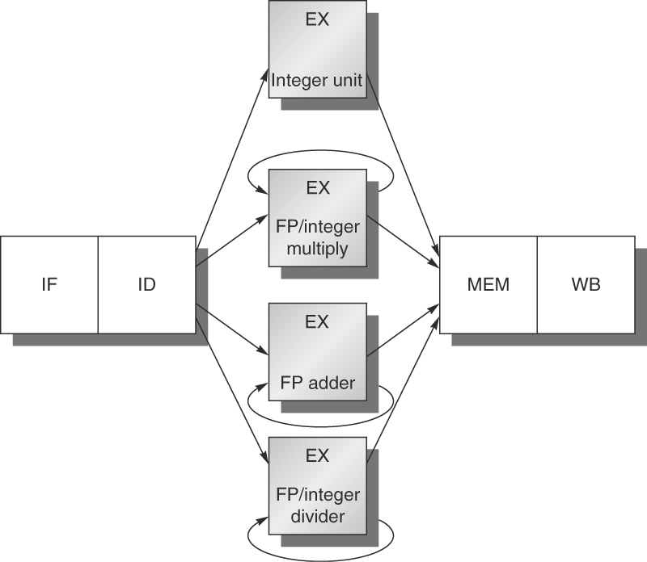

Slide 10
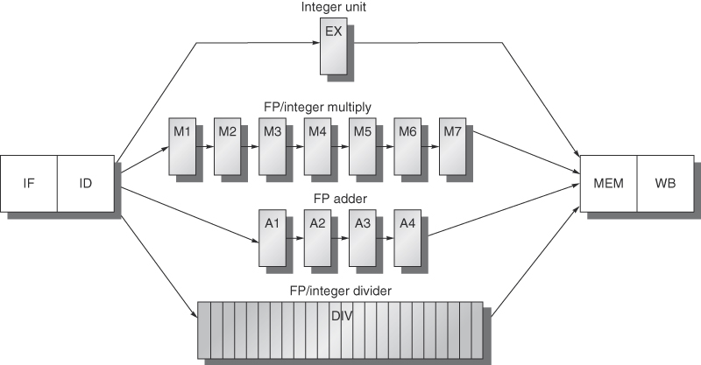
(25 stages)

Slide 11
Resulting Pipeline
Timing of a set of independent FP operations:
MULTD IF ID M1 M2 M3 M4 M5 M6 M7 MEM WB
ADDD IF ID A1 A2 A3 A4 MEM WB
LD IF ID EX MEM WB
SD IF ID EX MEM WB
Problems
1. Divide FU is not pipelined → may suffer structural hazards
2. Because instructions have varying running times, we
may try several WB in same cycle

Slide 12
L.D F8, 0(R2)
Structural hazard if register file has only 1 write port
Solution:
Detect in ID stage and stall before issue
Or, detect before entering MEM or WB stage and allow only 1 to proceed

Slide 13
3. Because instructions do not reach WB in order → WAW possible
- In previous fig, if load were issued 1 cycle before and used F2 instead of F8, we would have WAW
-- Stall LD or turn ADD into NOP.
- WAR not possible : why?
4. Instructions can complete out of order → problems with exceptions
5. Long latency operations → frequent RAW stalls
MULTD IF ID M1 M2 M3 M4 M5 M6 M7 MEM WB
F0,F4,F6
ADD IF ID -- -- -- -- -- -- A1 A2 A3 A4 MEM
F2,F0,F8
SD F2,6(R2) IF -- -- -- -- -- -- ID EX -- -- MEM
Notes:
Because reg always reads in ID

Slide 14
Take a look at C-6 (MIPS R4000)

Slide 15
Dealing with exceptions
Exceptions:
Normal execution order of instructions is changed
Sometimes referred to as interrupt and fault
Examples of exceptions:
I/O device request,
invoking an OS service from a user program,
breakpoint,
integer arithmetic overflow and underflow
page fault etc.
Overlapping of instructions in a pipeline makes it hard to deal with exceptions

Slide 16
Difficulty
Implementing interrupts occurring within instructions is difficult
How to do it? Invoke another code that
Save the state of the executing program
Correct the cause of the exception
Restore the state of the program before the inst that caused exception
Retry the instruction
Process invisible to program
If pipeline allows machine to save state, handle exception, and restart without affecting the execution of program: restartable machine or pipeline
All machines today are restartable (at least for int pipeline)

Slide 17
Exceptions in Integer MIPS
IF: page fault on I-fetch, misaligned memory access, memory protection violation
ID: undefined/illegal opcode
EX:
MEM:
WB:

Slide 18
Exceptions in Integer MIPS
IF: page fault on I-fetch, misaligned memory access, memory protection violation
ID: undefined/illegal opcode
EX: arithmetic exception
MEM: page fault on D-fetch, misaligned memory access, memory protection violation
WB: none

Slide 19
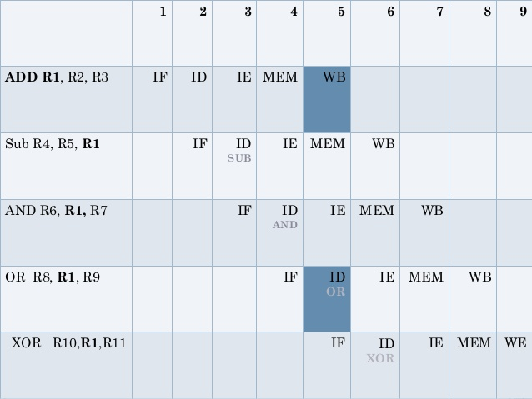

Slide 20
Explanation

Slide 21
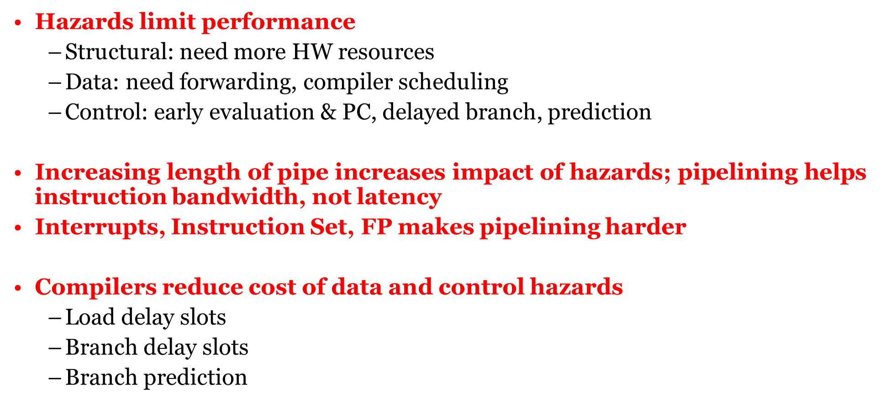
Summary

